Slide 1

News Articles and Blog Posts Recommendation System.
GitHub Link: https://github.com/skshohaib11/Data_Detectives
Team Name: Data Detectives.
Members: Shohaib Shaikh.

Slide 2
What is a recommendation system?
A recommendation system is a personalized guide that offers tailored suggestions using user data to suggest relevant choices based on their preferences, improving user experience.
Types of recommendation systems?
Popularity-Based Recommendation Systems.
Classification-Based Recommendation Systems.
Content-Based Recommendation Systems.
Collaborative Filtering.

Slide 3

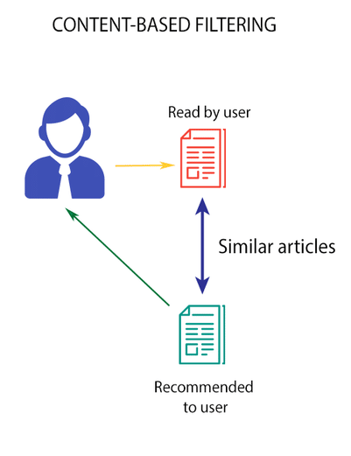
What are we going to focus on?
Our focus area is Content-Based recommendation as it works on the similarity between different contents of different users.
The system will give more efficient recommendations if we have a large volume of information about users and the contents of user’s interests.

Slide 4

Aim of our project and its Significance.
The aim of our project is to design a recommendation system that can suggest personalized news articles or blog posts to users based on their reading history and interests.
The system should be able to learn and adapt to the user’s preferences over time and provide relevant and engaging content.

Slide 5
Data Collection and Preprocessing.
Data Collection.
Data Preprocessing.
We have collected the data from Kaggle as we found that the data has more relevant features and a good amount of data which will help our model to understand better.
Null values treatment.
To check for duplicate data and its treatment.
Feature Importances.

Slide 6
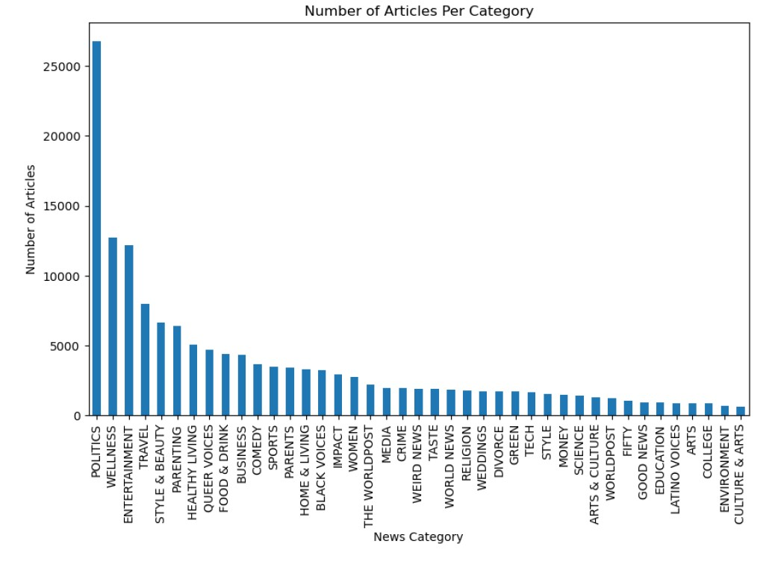
Exploratory Data Analysis.
Top 3 categories:
Politics.
Wellness.
Entertainment.
Bottom 3 categories:
Culture & Arts.
Environment.
College.

Slide 7
Text Processing.
Data Cleaning and Preprocessing
Stopwords Removal
Lemmatization

Slide 8
Methodology.
Generally, we calculate the similarity based on the distance. Say if the distance between 2 items is minimum then we can say that these 2 items have high similarity and if the distance between these items is maximum we say that these items have low similarity.
So we need to represent this text data in a numerical format and then we can find out the similarity based on distance.
There are multiple methods to represent the text in numerical format. In this project, we have used the Bag of Words and TF-IDF method (Term Frequency-Inverse Document Frequency).

Slide 9
How do these techniques actually work?
Test Doc: Life Learning.
Doc 1: The game of life is a game of everlasting learning
Doc 2: The unexamined life is not worth living.
TF for test doc
Test Doc: Life Learning
TF: 1 1
TF for Doc 1
Doc 1: The game of life is a everlasting learning
NTF: 1 2 2 1 1 1 1 1
Normalized TF for test doc
Test Doc: Life Learning
NTF: 0.5 0.5
Normalized TF for Doc 1
Doc 1: The game of life is a everlasting learning
NTF: 0.1 0.2 0.2 0.1 0.1 0.1 0.1 0.1
Euclidean Distance
D = √[(x₂ – x₁)² + (y₂ – y₁)²]
D = √[(0.5 – 0.1)² + ( 0.5– 0.1)²]
D = 0.56

Slide 10
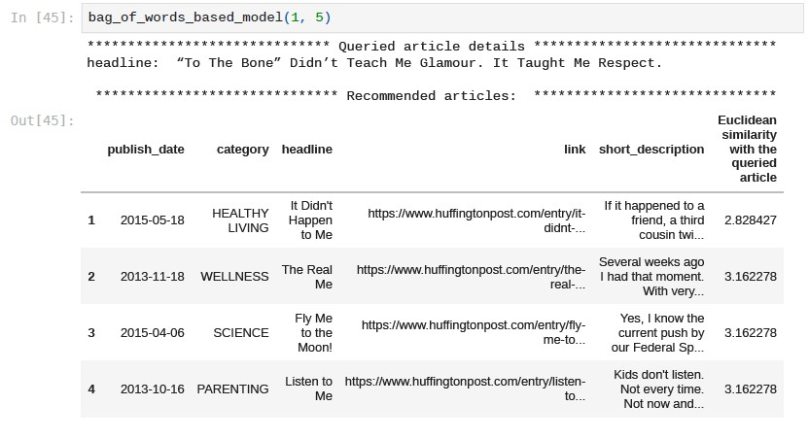
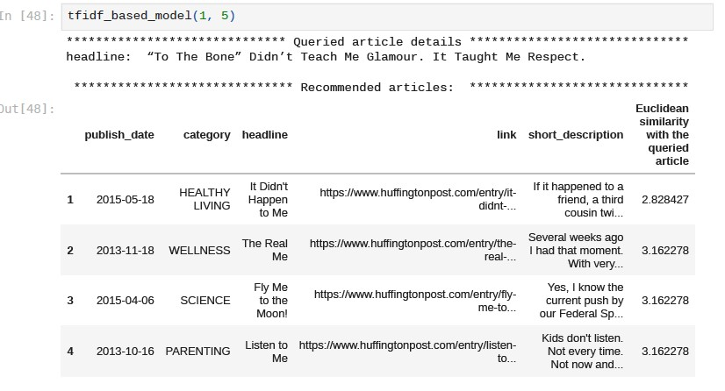
Models recommendations.
Using Bag of Words
Using Tf-Idf

Slide 11
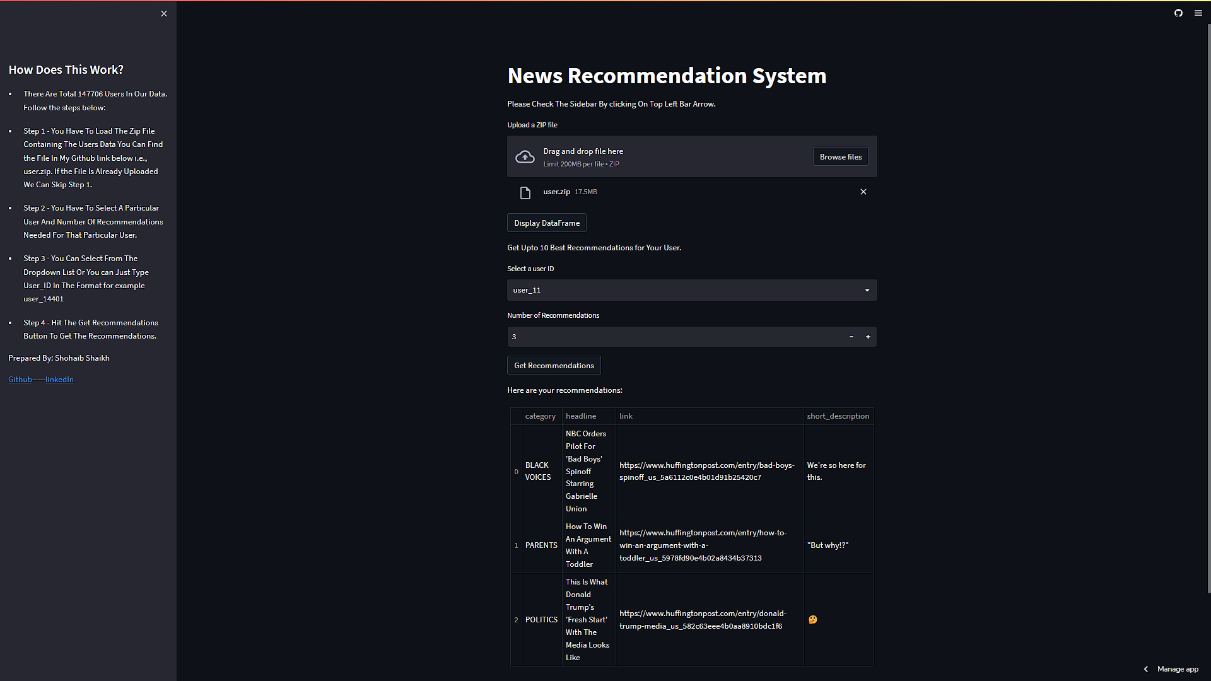
Web application using streamlit.
https://skshohaib11-data-detectives-recommendation-dijael.streamlit.app/

Slide 12
Conclusion.
In This project we have successfully been able to build a content-based recommendation model which will give news and blog posts recommendations to users based on their reading history.
In the future we will be working on gathering more data and applying techniques like Word2vec embeddings and different metrics using cosine similarity, weighted similarity, and Jaccard similarity with the aim of improving the recommendations to users.

Slide 13
References.
Kaggle.com
starkoverflow.com
docs.streamlit.io/

Slide 14


